Slide 1


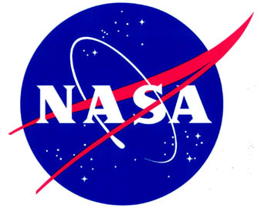
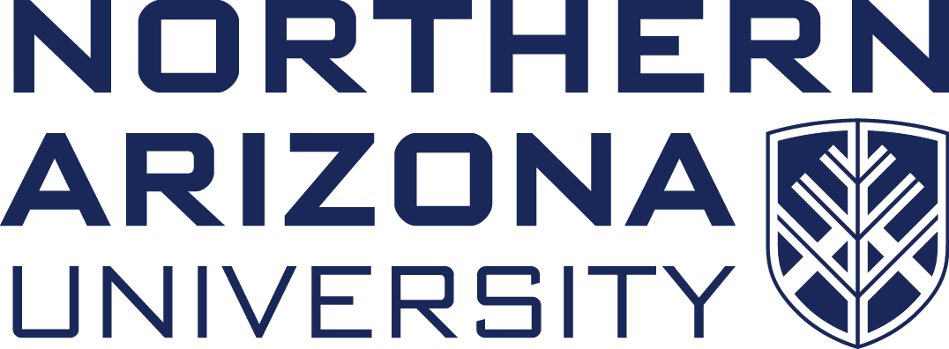
Uranium, Radon, and Radiation Outreach
Athena Talk
Mentor: Mansel Nelson
Northern Arizona University

Slide 2
Background
From 1944 to 1971, nearly 30 million tons of uranium ore were extracted from Navajo lands.
Due to a drop in the price of uranium, mining operations ceased leaving more than 500 mines behind across the reservation.
Law and Policy Initiatives
  Uranium Mill Tailings Remedial Action (UMTRA) cleanup program enacted in 1978
  Radiation Exposure Compensation Act enacted in 1990; RECA amendments, 2000, 2015

Slide 3
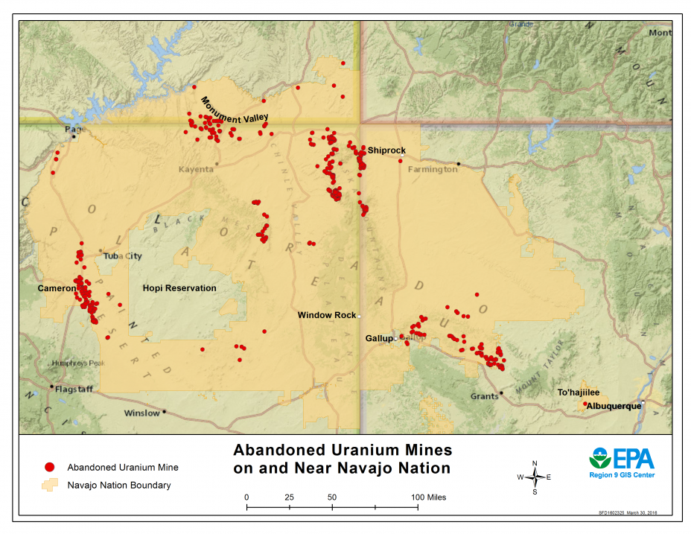

Slide 4
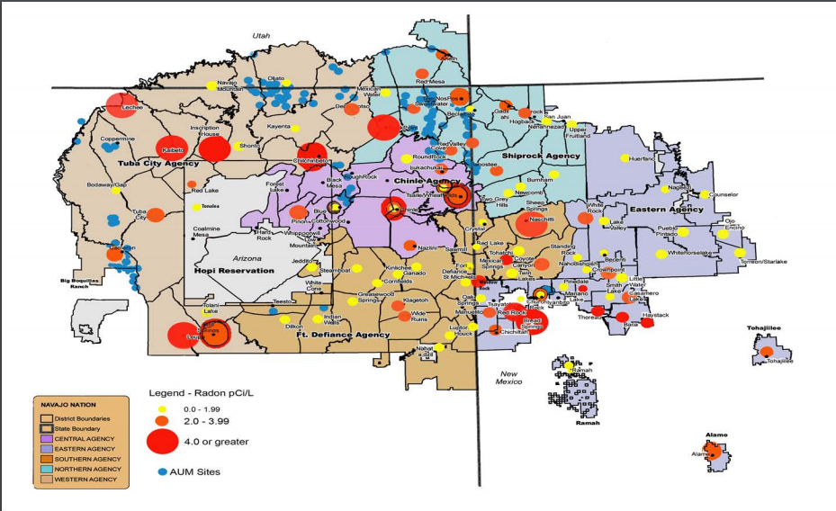

Slide 5
Why is this important?
In 2015, the Community Outreach Network was created to coordinate communication with residents about actions addressing uranium contamination on the Navajo Nation.
The goal is to inform Navajo students grades K-12 with curriculum that educates students of the harms that uranium, radiation, and radon has on the environment and health, and how to protect themselves in a way that is understandable.
Educational outreach is limited in reservation schools and depends greatly on teachers interest and funding
Notes:
Community Outreach Network includes awareness of health and environmental issues, and the distribution of correct scientific information in attempt to reduce fear

Slide 6
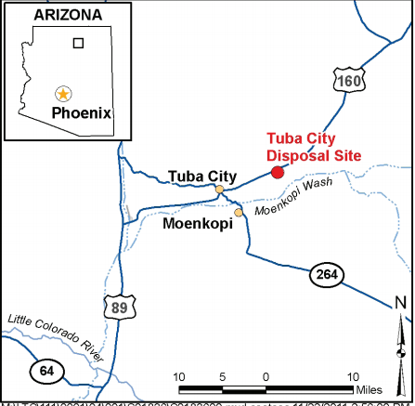
Tuba City Uranium Mill Site
Mill was in operation between 1956 and 1966. During its operation the Tuba City mill processed about 800,000 tons of uranium ore.
In 1988 the Department of Energy (DOE) cleaned up the materials from the former milling operations in a disposal cell containing about 2.5 million tons of residual radioactive material.

Slide 7
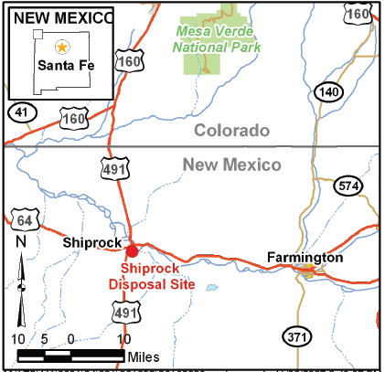
Shiprock Uranium Mill Site
The mill was in operation from 1954 until 1968.
By September 1986, all tailings and associated radioactive material were encapsulated in the disposal cell built on top of the existing tailings piles.
Notes:
Kerr-McGee and VCA

Slide 8
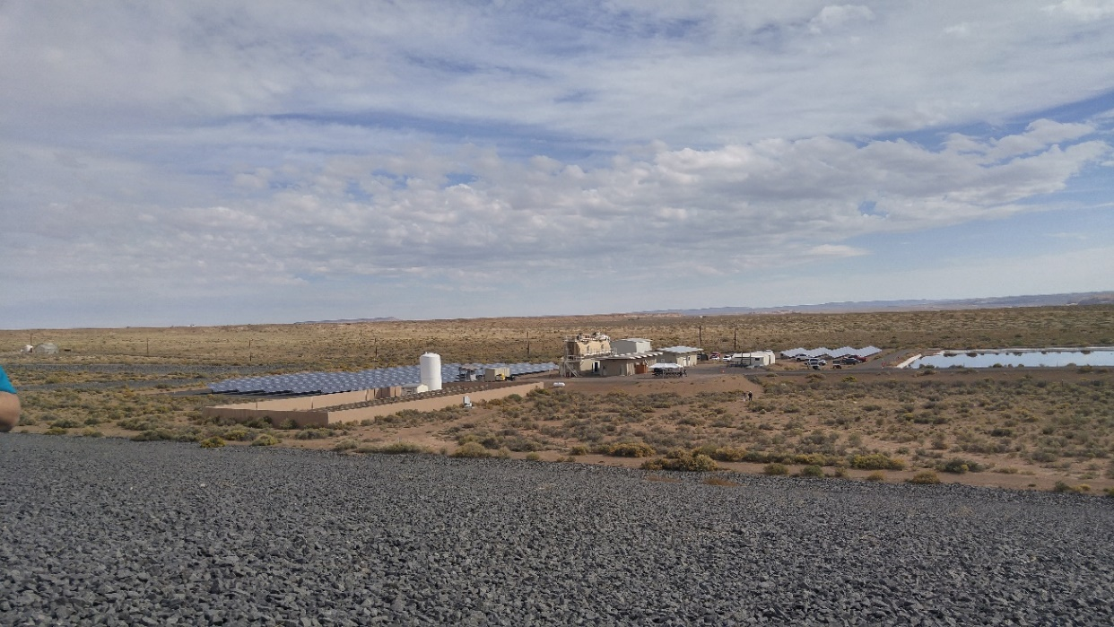
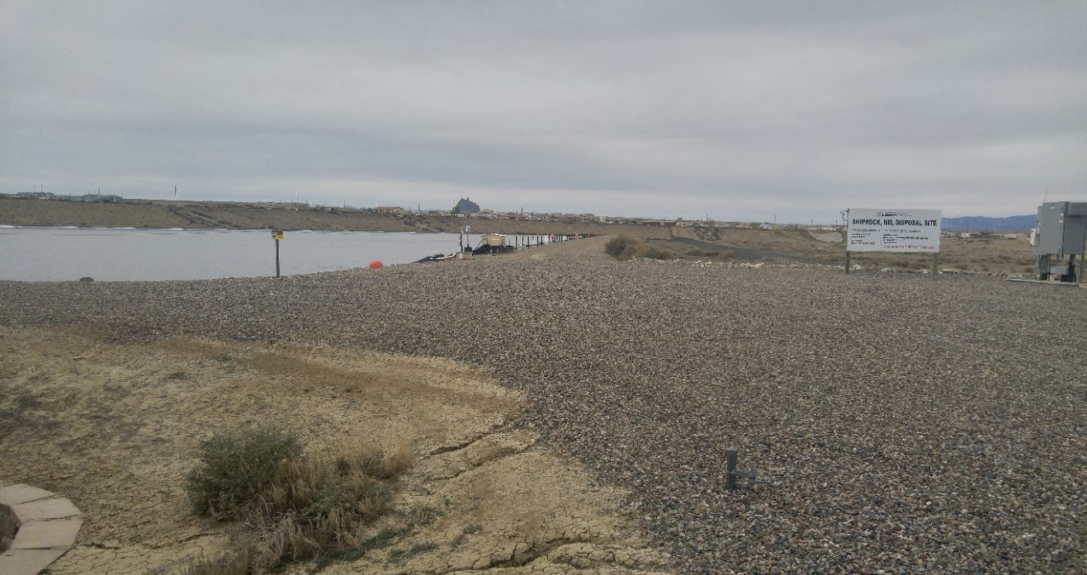
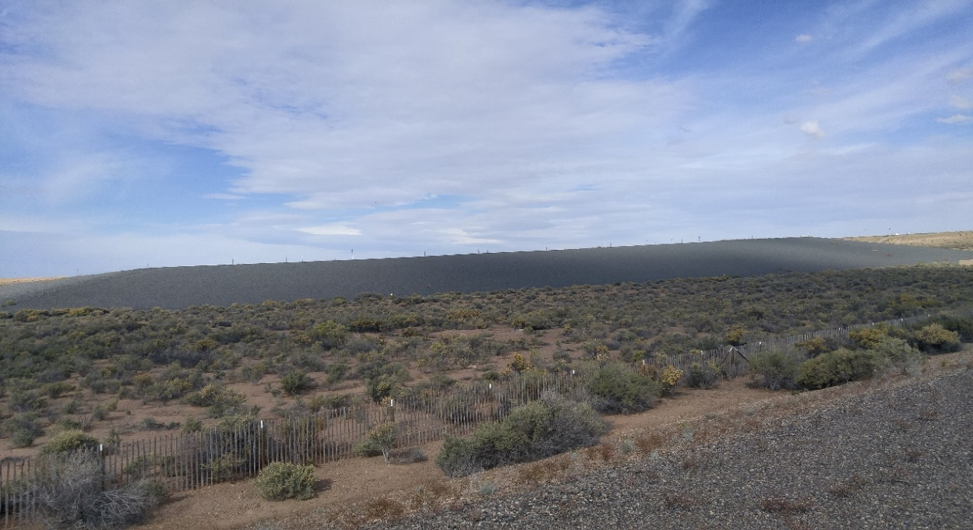
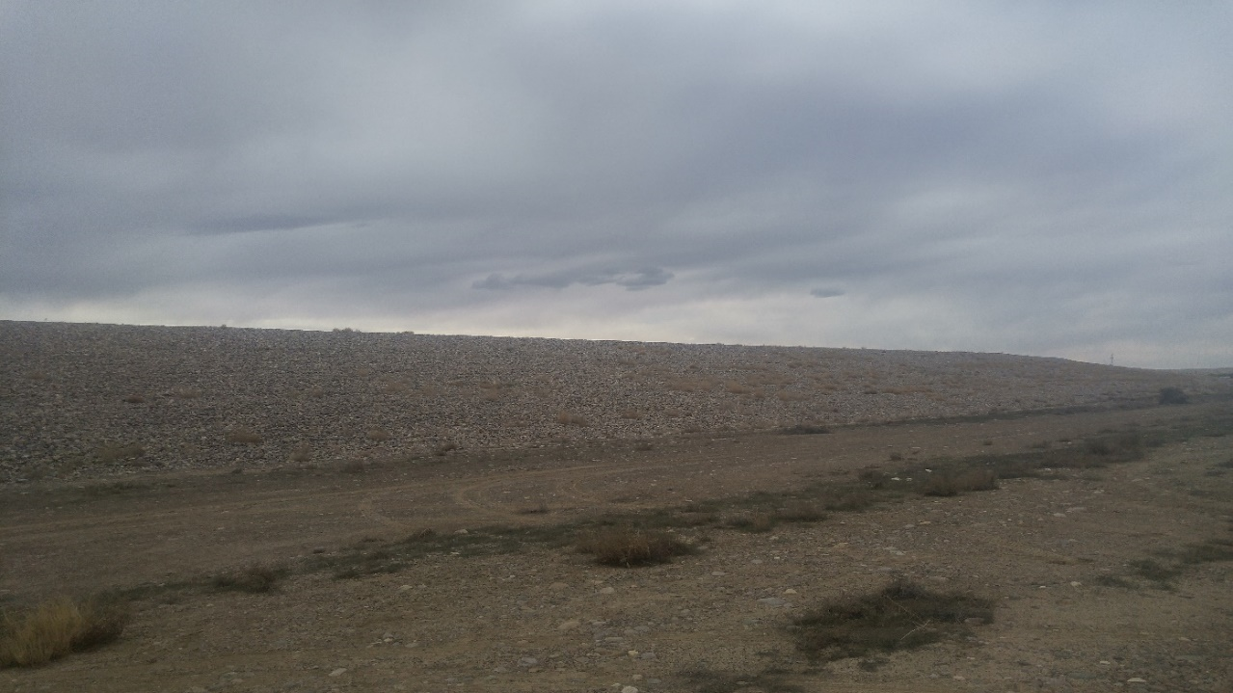
Tuba City Rare Minerals Site
Shiprock Disposal Site

Slide 9
Tuba City Uranium Open House
October 28, 2016
Shiprock Uranium Open House
March 25, 2017
An opportunity for Navajo residents to talk with agency representatives and receive information about the work each agency is doing to address uranium contamination on Navajo Nation.
Agencies that were present included
  NNEPA, AML/UMTRA, U.S. EPA, U.S. DOE, BIA, NRC, IHS, AUM, and Navajo Birth Cohort Studies

Slide 10
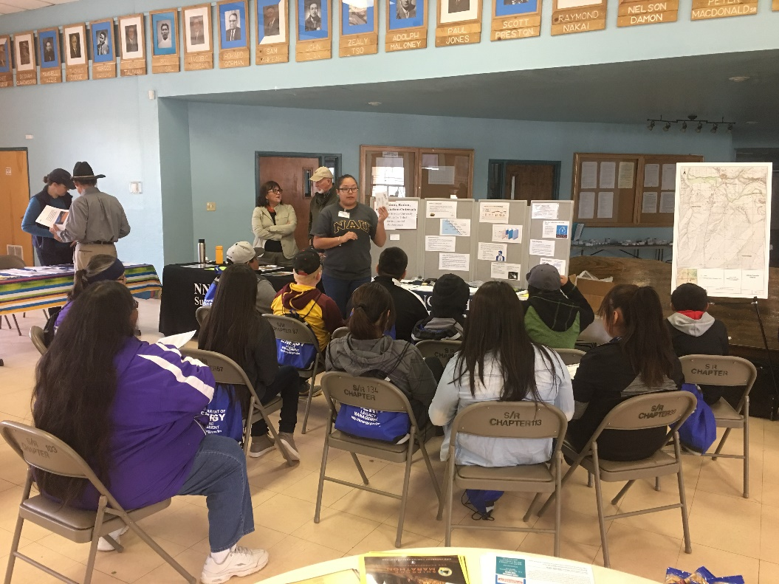
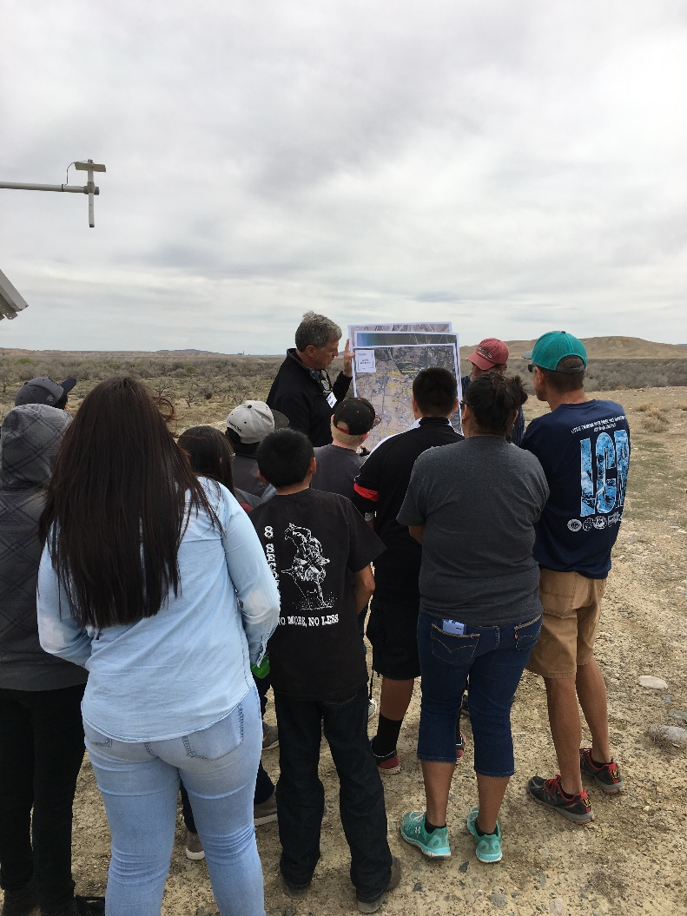
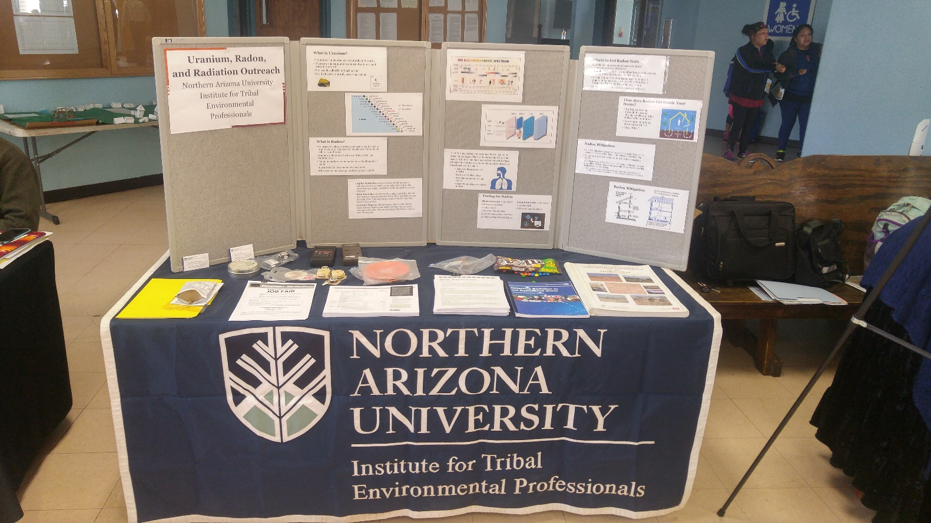
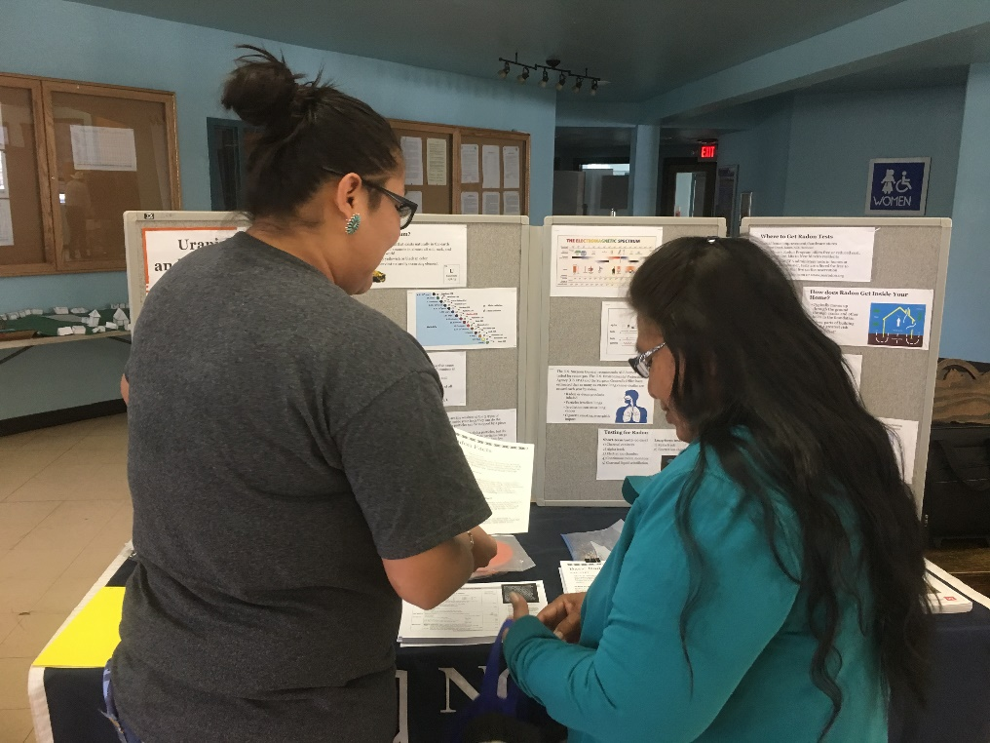
Shiprock Open House
March 25, 2017

Slide 11
Educational Outreach
March 13-17, 2017
Community
  Two Grey Hills, Tohaalí, Sheepspring, Naschitti
  Offered residents in home radon test kits, information about radon, and spread the word about SR Open House
Schools
  Newcomb HS
  Kirtland Central HS
  Tohaalí Community School
Purpose
  Offer students information about the legacy of uranium mining, and teach students about radon and radioactivity.

Slide 12
Ongoing Efforts on the Navajo Nation
Resolution 0057-17 “An Action Relating to Health, Education, and Human Services and Naabik’íyáti: Opposing Uranium Mining on the Navajo Nation and/or Any Plans to Resume Such Mining”
$600 million settlement for cleanup and remediation (Freeport McMorRan Inc.)
EPA Language Grant (Perry Charley of Diné College)
Diné Uranium Remediation Advisory Committee
Notes:
DURAC :the purpose of the Commission is to study and reach conclusions about the impacts of uranium mining and processing on the Navajo nation and to make recommendations to the President of Navajo Nation and to the Navajo Nation Council for policies, laws and regulations to address those impacts.

Slide 13
Acknowledgements
NAU ITEP
  Mansel Nelson
NAU NASA Space Grant
  Kathleen Stigmon
  Nadine Barlow

Slide 14
QUESTIONS?

